Slide 1



Slide 2

Rockets, Railroads, and Writing
Ginger Pinholster and
Crissa-Jean Chappell

Slide 3

Sisters from another mister?
- Matthew Field: Two American Alligators (Wikimedia Commons)

Slide 4
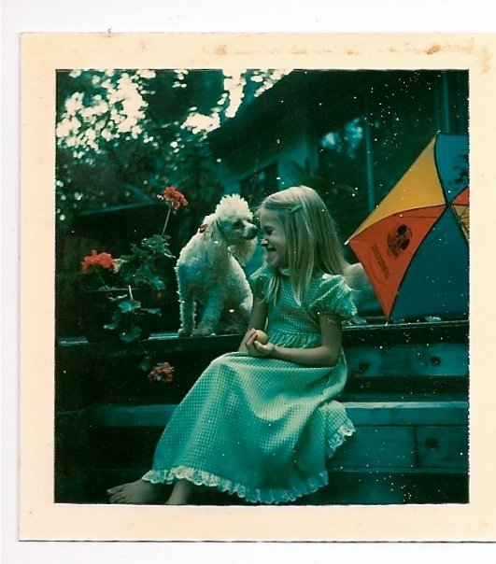
Crissa-Jean Chappell – SWAMP QUEEN
Born in Miami, lives in Brooklyn
Never Leave Me Alone (Regal House)
Other award-winning novels
Florida weirdness shines in her writing
PhD, MFA, professor at Lehman College

Slide 5
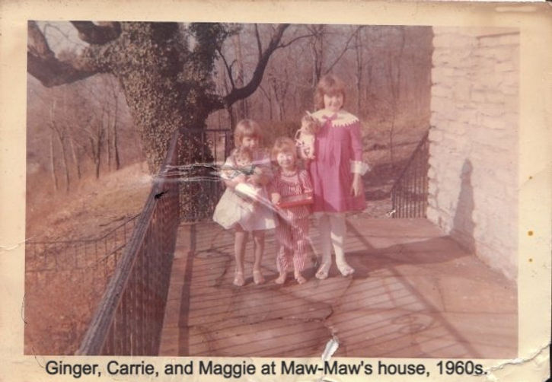
Ginger Pinholster – TURTLE WITCH
Lives in both Florida and New Mexico
The Train to Santa Fe (also from Regal House)
Florida weirdness, check: Snakes of St. Augustine
Former adjunct and administrator, Embry-Riddle
MFA, science writer = 40 yrs

Slide 6
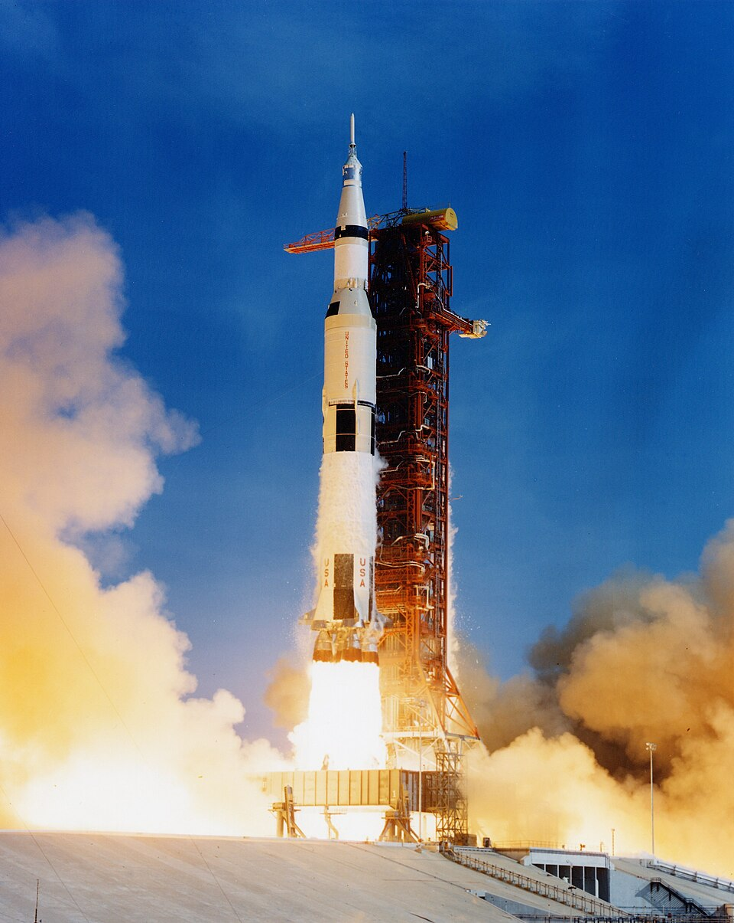
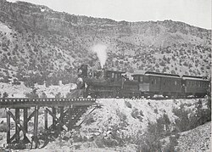
What do our books have in common?
The impacts of technology on people, culture, and community
Immersive setting as character

Slide 7
Our boilerplates

Slide 8
Our boilerplates

Slide 9
Fan-girl time: My blurb of NLMA
Crissa-Jean Chappell’s stunningly vivid, emotionally wrenching YA thriller, focused on a teen girl in peril, raises important questions about social media addiction and the true human impacts of economic disparity.
At a relentlessly suspenseful pace, Never Leave Me Alone exquisitely renders the stark contrast between Florida’s glittering Space Coast wealth and decaying fringes, where creative, traumatized Riley-Jane struggles to survive …

Slide 10
My blurb of NLMA - continued
It’s a land where rockets pop off like corks, while on the ground, the air is thick with fried Twinkies and bull-riding pens …
Chappell masterfully serves up a mysterious roller coaster ride full of twists and turns that will keep readers eager to learn what happened, “who done it,” and whether her irresistible young protagonist will be able to overcome adversity.
Every sentence is a heartbreaking, vivid jewel, thanks to the author’s astonishingly precise descriptive powers.

Slide 11


“Hey, Ginger, why did you write your book?”
Craft workshop
Cute cowboy

Slide 12
A reading from The Train to Santa Fe
This novel is fundamentally a love story, so I’m going to read from a romantic scene.
Here, Jonah is on a blind date with a wounded veteran named Jemi.
More than anything, Jemi wants to climb a certain mountain to reclaim her sense of wholeness.
To do this, she needs Jonah’s help … This scene is in Jonah’s POV.

Slide 13
The impacts of technology on people, culture, and community
In NLMA, seventeen-year-old Birdie’s waiting for a rocket launch in her dying Florida beach town when you write this:
  “The moon is a thin blade above the sea wall. As I move toward the boardwalk, I think about that American flag the astronauts left behind. Maybe it crumbled into dust. Or maybe it’s still there, bleached white and waving in surrender.”
The arrival of rockets to the Space Coast has a profound impact on the people who live there – and get left behind by the economic boom.

Slide 14
The impacts of technology on people, culture, and community
In Train, a young Tewa potter boards one of the first trains to Santa Fe, triggering generational impacts. Decades later, her granddaughter remembers the story:
  “When the iron horse first rocketed into Española, silver rods pumping, spewing clouds of fire and steam until Chenoa, at sixteen, worried her ears might bleed, she had never seen anything so sure of itself, and the prospect of seeing another part of New Mexico left her dry-mouthed with desire.”

Slide 15
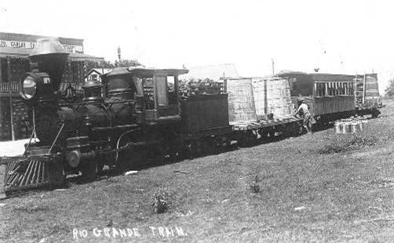
Let’s talk about the Chili Line (1887 – 1941)

Slide 16
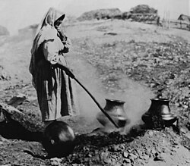
The Chili Line’s impact on Native artwork
Sara Fina Gutierrez Tafoya firing blackware at Santa Clara Pueblo, c. 1900.
(From Wikimedia Commons)

Slide 17
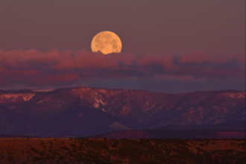
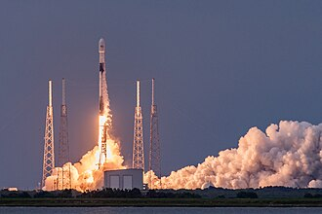
Settings as characters

Slide 18
Why do we write?
What do we hope readers will gain?

Slide 19
Questions?

Slide 20
Thank you for your attention! www.GingerPinholster.com www.crissajeanchappell.com

